Slide 1
Transform
Amrom Obstfeld
R/Medicine 2020

Slide 2
The Data Analysis Pipeline
From R for Data Science (https://r4ds.had.co.nz/introduction.html)
Notes:
This is the generalized data science pipeline that was introduced to you yesterday. The functions we'll be learning about fit specifically in the "tidy" and "transform" portions of this workflow.

Slide 3
Notes:
In this session we'll be using functions that are part of the dplyr package. The dplyr package is part of the tidyverse meta-package and a workhorse for data transformation.

Slide 4
a grammar for transforming data frames
Notes:
Now dplyr isn't just a haphazard collection of functions. It takes a holistic almost philosophical approach to the transformation of data and implements it in an organized lexicon or grammar for programmatically transforming data.
What I mean when I say a grammar for transforming data really relates to 2 characteristics of the dplyr approach.
#1 In a similar way to how verbs operate on nouns, dplyr functions operate on a data frames.
#2 Dplyr functions use a consistent syntax which minimizes cognitive load so once you understand the dplyr approach with one function its easier to learn new functions in dplyr and will talk about that in a few more slides.

Slide 5
Select existing columns

Slide 6
select()
Extract columns from a data frame
= Number of rows
↓ Number of Columns
Notes:
Here you see the graphical framework for how select works. You provide the raw data as the input in the form of a data frame.
It will extract the columns of your choosing from and return these columns as a new data frame.
In the output, you will wind up with all the rows that you started with and the columns defined in the select function.

Slide 7
select()
Extract columns from a data frame
select(data,... )
select(covid_testing, mrn, last_name)
data frame to transform
dplyr function
data frame to transform
name(s) of columns to extract
Notes:
You can see here that select() conforms to the syntax of all dplyr functions.
Select takes the starting data frame as its first argument. In this case it’s the "covid_testing" data frame.
After that it takes any number of additional arguments that specify the columns that you want to pick.
In it’s simplest form, those additional arguments will just be the names of the columns that you want to select. Like in this case we are indicating that we want to keep the mrn and last_name columns.
In very wide datasets, writing out the names of the columns you want just doesn’t scale so dplyr does have additional convenience functions that can help you succinctly identify the columns you want. We won't go over these together but they can be found in the data transformation cheat sheet in the appendix to your coursebook.

Slide 8

select()
Extract columns from a data frame
select(covid_testing, mrn, last_name)
description | department
PROTHROMBIN TIME | INTERNAL MEDICINE CLINIC
BASIC METABOLIC PANEL | INTERNAL MEDICINE CLINIC
THYROID STIMULATING HORMONE | ENDOCRINOLOGY CLINIC
T4, FREE | ENDOCRINOLOGY CLINIC
covid_testing
mrn | first_name | last_name | gender
5000876 | sarella | stark | female
5006017 | alester | stark | male
5001412 | jhezane | westerling | female
5000533 | penny | targaryen | female
mrn | last_name
5000876 | stark
5006017 | stark
5001412 | westerling
5000533 | targaryen
…
…
Notes:
So for example, if you were to run the code you see here, the snippet of the covid_testing data frame on the left would be accepted as input and a subset of it, the mrn and the last_name would be returned as output

Slide 9
Pop Quiz
…

Slide 10
Filter rows by logical criteria

Slide 11
filter()
Extract rows that meet logical criteria
↓ Number of rows
= Number of Columns
Notes:
Here you see the graphical framework for how filter works. You provide the raw data as the input in the form of a data frame.
Filter will use logical criteria you provide in the function to identify the rows that are required
In the output, you will wind up with all the columns that you started with and just the rows defined in the filter function.

Slide 12
filter()
Extract rows that meet logical criteria
filter(data, ...)
logical test
(return each row where
the test is TRUE)
data frame to transform
 |  |  | FALSE
 |  |  | FALSE
 |  |  | TRUE
 |  |  | FALSE
 |  |  | TRUE
 |  |  | FALSE
Notes:
In filter the first argument again is a data frame from which we will be extracting rows.
Afterwards we can input one more logical tests. R then performs that logical test on each row of the dataset and returns all rows in which the logical test is TRUE. Rows for which the tests are TRUE are returned in the output as a data frame and the rest are removed.
The key point here is that the logical tests are evaluated row by row, one at a time, independently.

Slide 13
filter()
Extract rows that meet logical criteria
filter(data, column_name == criteria )
logical test
(return each row where
the test is TRUE)
 |  |  | FALSE
 |  |  | FALSE
 |  |  | TRUE
 |  |  | FALSE
 |  |  | TRUE
 |  |  | FALSE
Notes:
Let's zoom in for a second on those logical tests.
Generally speaking they will take this form.
There will be some column that contains the data you want to filter on, like the clinic name, or the patient MRN.
Then there will be a logical test, what you see here is equals, you can also have greater than, less than etc.
And then you have the criteria. Equal to what? Greater than what number?
OK let's see some real examples →

Slide 14
filter(covid_testing, mrn == 5000083)
mrn | first_name | last_name
5000876 | sarella | stark
5006017 | alester | stark
5001412 | jhezane | westerling
5000083 | lollys | clegane
mrn | first_name | last_name
5000083 | lollys | clegane
FALSE
5000876 | sarella | stark
FALSE
5006017 | alester | stark
FALSE
5001412 | jhezane | westerling
TRUE
Notes:
Here's an example. We supply the covid_testing data frame as the first argument. Afterwards we provide one logical test; we ask filter() to return rows in which the mrn is 5000083.
Filter will go row by row, starting from the very first row and ask is the value in the mrn column equal to 500083 for that row, as you can see it's not – so it gets an imaginary value of false. →
It then goes to the second row, again checks to see if the mrn is a match, it's not so it also get's a false.→
And so on for the third →
But in the fourth you can see we do have a match – so that gets a TRUE. →
So the output of this function is a data frame with the same number of columns but only the rows that resulted in a TRUE based on the criteria in the function

Slide 15
filter(covid_testing, mrn == 5000083)
mrn | first_name | last_name
5000876 | sarella | stark
5006017 | alester | stark
5001412 | jhezane | westerling
5000083 | lollys | clegane
= sets
(returns nothing)
== tests if equal
(returns TRUE or FALSE)
data frame to transform
Notes:
Note that I used double equals inside of the logical test. Double equals means: compare the left hand to the right hand sides and if it’s the same, then return TRUE. The double equals is called the comparison operator. In contrast, a single equals sign sets a variable (the left side) to a value (usually on the right). It is a very common mistake to accidentally use a single equals inside of the filter function, which will result in an error.

Slide 16
Values coded as character strings must be surrounded by quotes
filter(covid_testing, last_name == "stark")
mrn | first_name | last_name
5000876 | sarella | stark
5006017 | alester | stark
5001412 | jhezane | westerling
5000083 | lollys | clegane
mrn | first_name | last_name
5000876 | sarella | stark
5006017 | alester | stark
TRUE
TRUE
FALSE
FALSE
Notes:
Similarly we can ask filter to return just the rows that represent tests for a specific patient, like stark.
In this case the first two rows result in TRUE and so are kept
Note that when asking filter to return rows with specific text inside of it, we have to put that text in quotes and it's got to be an exact match, partial matches don't count.

Slide 17
filter()
Extract rows that meet logical criteria
filter(data,... )
logical test
(return each row where
the test is TRUE)
data frame to transform
data frame to transform
Notes:
So what we've seen is that the output of a filter() function is completely dependent on the logical operators in this green square. Rows in which the logical statement results in a TRUE are returned and those that are FALSE will not be returned. So the next question of course is how do you construct logical statements in R.

Slide 18
Logical tests
x < y | Less than
x > y | Greater than
x == y | Equal to
x <= y | Less than or equal to
x >= y | Greater than or equal to
x != y | Not equal to
Notes:
R provides logical operators for every occasion. Here are just some of the important logical operators to know about.
We’ve already seen the double equals. Theres also the less than or and greater than operators. These each also come as “or equal to” versions.
Use exclamation point-equals (!=) if you want to select rows in which a value is not equal to something else.

Slide 19
Pop Quiz
What is the result?
1 == 1

Slide 20
Pop Quiz
What is the result?
3 != 1

Slide 21
The pipe operator %>%

Slide 22
The Pipe Operator %>%
Passes result on left into first argument of function on right.
%>%
covid_testing
filter(____, pan_day <= 10)
filter(covid_tesing, pan_day <= 10)
covid_tesing %>% filter(pan_day <= 10)
Notes:
This is exactly what the pipe operator does.
The pipe operator is this percent, greater than, percent symbol. It's a tool that we use to glue the pieces of our analysis together into one pipeline.
The pipe operator does something very simple but at the same time incredible useful. It takes the product of whatever is on the left and puts it into the function on the right.
So for example, the two lines of code in the gray box do exactly the same thing.
There are a whole bunch of reasons as to why this is a useful thing but for me, one of the most important reasons is that it turns computer code into something that is almost legible as human language.
You could essentially read the second line of code as “Take the covid_testing data frame, and then filter the pan_day column to rows that are less than or equal to 10.”

Slide 23
day_10 <- select(
filter(
covid_testing,
pan_day <= 10
),
clinic_name
)
Notes:
The advantage of this is even more clear when performing a more complicated analysis such as this one. You can take this code, which is essentially illegible, and transform it into the code on the following slide.

Slide 24
covid_testing %>%
filter(pan_day <= 10) %>%
select(clinic_name)
Notes:
The code here is far more succinct. It's essentially self describing since it’s written in a sequential, essentially human readable format.
The pipe operator allows us to form chains that accomplish complicated data transformation operations but which are made up of very simple, self-contained, building blocks. So we're able to make something complex by joining together many simple elements that are easy to understand in isolation.
An additional benefit is that it makes it easier to actually write code because it's much easier to translate our thoughts into an analytical pipeline.

Slide 25
Pop Quiz
Which of the following is equivalent to:
a %>% b(c)
A. a(b(c))
B. b(a(c))
C. b(c, a)
D. b(a, c)

Slide 26
Create new columns

Slide 27
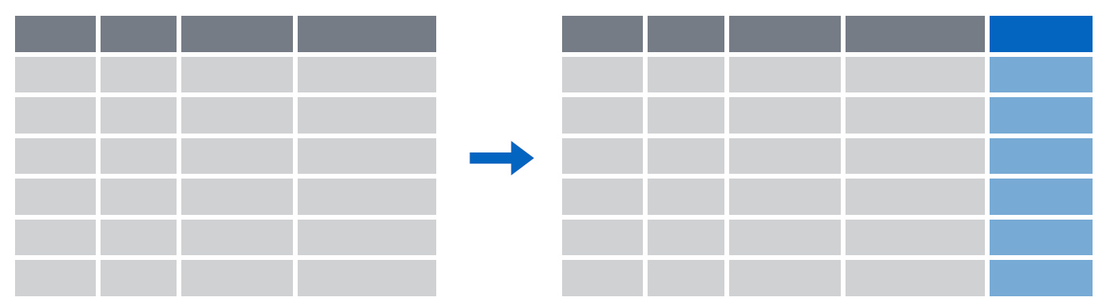
mutate()
Create new calculated columns
= Number of rows
↑ Number of Columns
Notes:
The goal of mutate() is very simple. You’ll feed it your original data frame and it’s going to kick out the same data frame with one or more new columns tacked onto the end based on calculations that you specify.

Slide 28
mutate()
Create new calculated columns
covid_testing %>%
mutate(new_column = calculation)
name for new column
single
equals
what to put in the new column
Notes:
The syntax is going to look familiar to the functions we saw earlier but with a small change. As before, the first argument is the original data frame, which gets piped into mutate. Then you specify the name of the new column you want to add, you type of an equals sign, and then you write a calculation. This calculation will be run on each row of your data frame and the result will populate each row of the new column.

Slide 29
mutate()
calculation can involve another column in the data frame
Create new calculated columns
covid_testing %>%
mutate(c_r_tat_mins = col_rec_tat * 60)
mrn | col_rec_tat | rec_ver_tat
5000876 | 29.5 | 11.5
5006017 | 3.6 | 5
5001412 | 1.4 | 5.2
5000533 | 2.3 | 5.8
mrn | col_rec_tat | rec_ver_tat | c_r_tat_mins
5000876 | 29.5 | 11.5 | 1770
5006017 | 3.6 | 5 | 216
5001412 | 1.4 | 5.2 | 84
5000533 | 2.3 | 5.8 | 138
Notes:
For instance, right now the TAT columns are coded in hourse. if we want to calculate the TAT in minutes we could use code such as this.
We take the covid_testing data set and pass it to the mutate function. In the mutate function we will
Make a name for our new column
Put an equals sign
Define the calculation whose result will populated the new column, in this case we can directl reference the col_rec_tat column and multiply by 60.

Slide 30
Your Turn #1
Open 04 – Transform.Rmd and do everything it asks you to do.
Click “yes” when you are finished.
Notes:
Might want to change to a pop quiz?

Slide 31
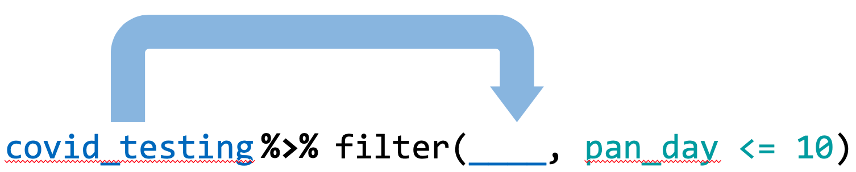
Recap
Extract columns with select()
Filter rows by logical criteria with filter()
Create new columns with mutate()
Use the pipe operator %>% to combine data transformation steps into a pipeline
Notes:
To recap what we covered up to this point, …
(**) Analyzing data with with Excel, or similar spreadsheet software, can compromise data quality, and may ultimately lead to patient harm. This is because Excel does not record user interactions and it’s easy to make simple errors that can be very difficult to uncover later.
(**) Instead, you could use a reproducible workflow in which the entire analysis is automated with computer code, and we looked at how doing that can improve your confidence in the validity of an analysis.
(**) and finally, we defined “computational document” as documents that have executable code inside of them and we went over how computational documents are a key ingredient of reproducible workflows.

Slide 32
What else?

Slide 33
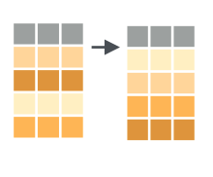
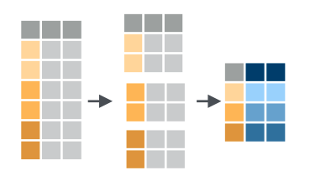
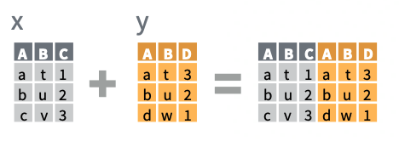
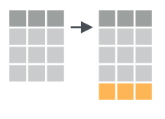
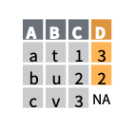
More dplyr functions
arrange(data, ...)
data %>%
group_by(...) %>%
summarize(...)
x %>%
bind_cols(y)
add_row(data, ...)
x %>%
left_join(y)

Slide 34
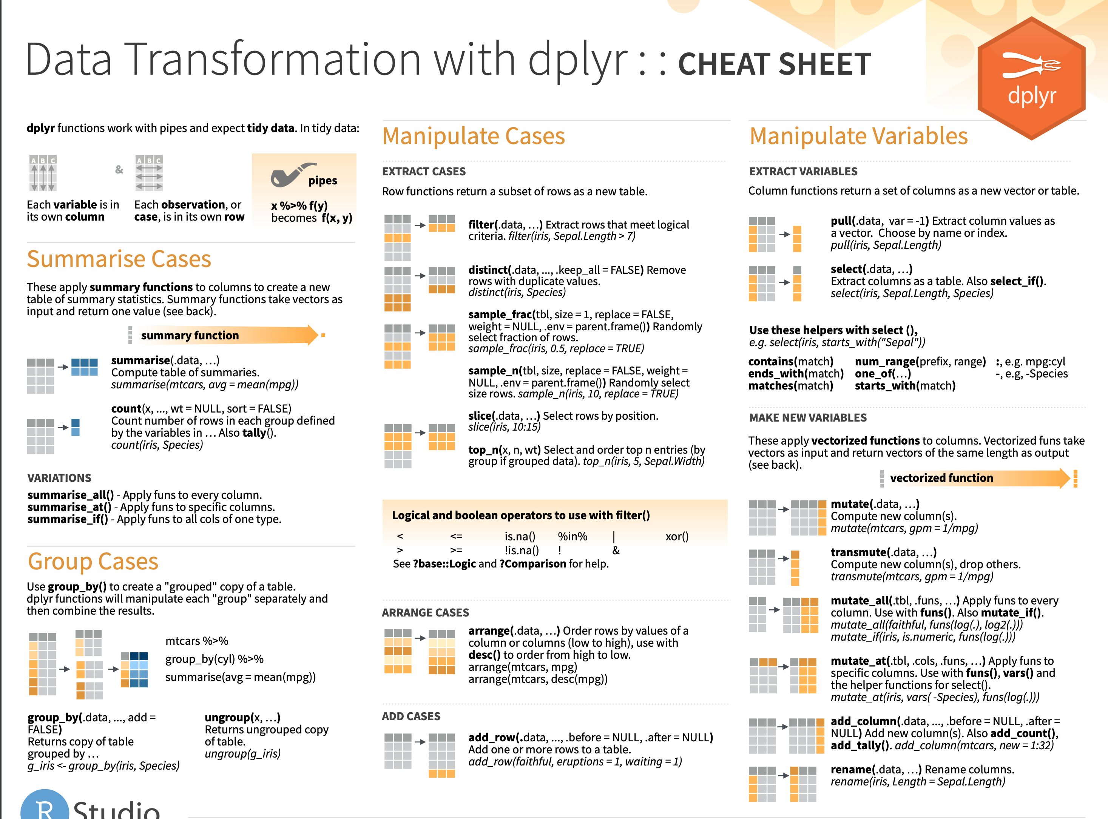
Notes:
Cheat sheets would go here

